Slide 1





Fidelity National Financial Marketshare Growth Partnership
Notes:
agent attraction,

Slide 2
A trifecta for Market Share Domination
Full access for your reps to the Forward Living Enterprise
2. Execute proven solutions to land mega agents and teams
3. Scale our Home Seller Attraction system where we direct title on each listing

Slide 3

1. Open Doors to Forward Living
#1 Out of 105 Kellar Williams Offices in California
$9.1B Total Sales Volume
5 offices in the prime locations in Los Angeles

Slide 4

2. The A B C’s Market Share growth with TitleGenie
Provide Title Reps a Biz Dev platform to open more doors and close more deals
Attract Great Agents - Genie patented analytics produce irresistible conversation starters
Build Trust - Bring value by being an INTEGRATED KEY PLAYER on listing team
Close Deals - Earn title orders before listings hit the MLS

Slide 5

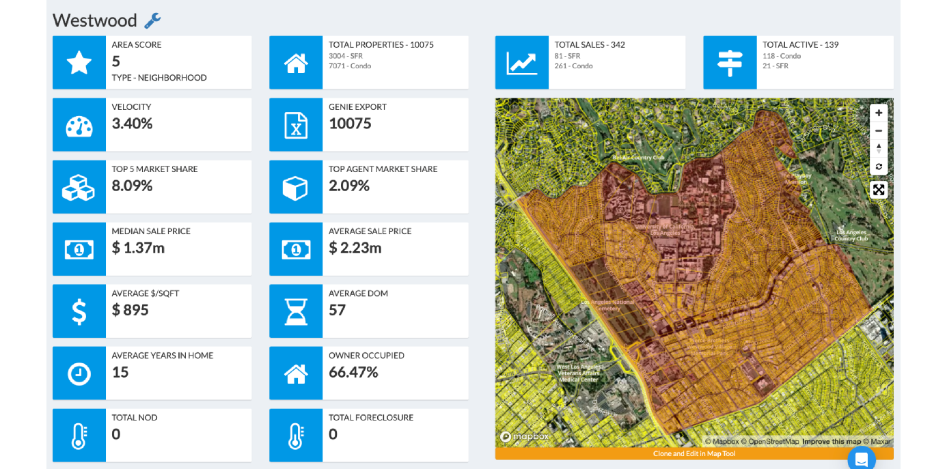
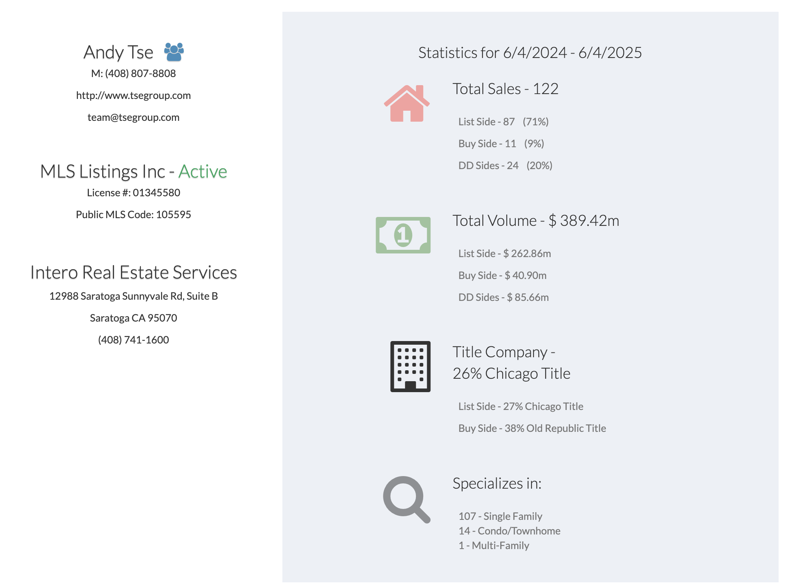
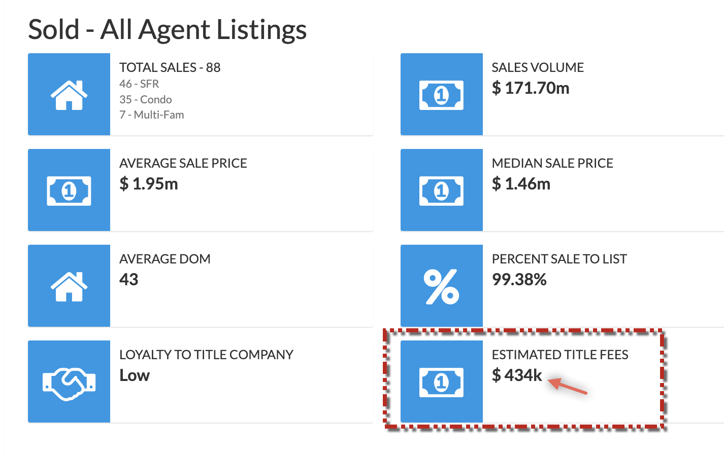
TheGenie.ai
Agent Attraction
“Teach an agent 1 thing they don’t know about themself, you will get in the door… every time”
Agent Scorecard - Select agents based on potential title revenue
Patented Farm Analyzer - Uncover “pockets of listing opportunities”
Share KNOWLEDGE competitors don’t have
Typical inferior options: Broker Metrics, Altos Research, MyMTA

Slide 6


Solutions for Attracting TOP REALTORS
High Value
The Genie.AI
Hard to Use
MyMTA
Easy to Use
Altos
Broker Metrics
Low Value

Slide 7
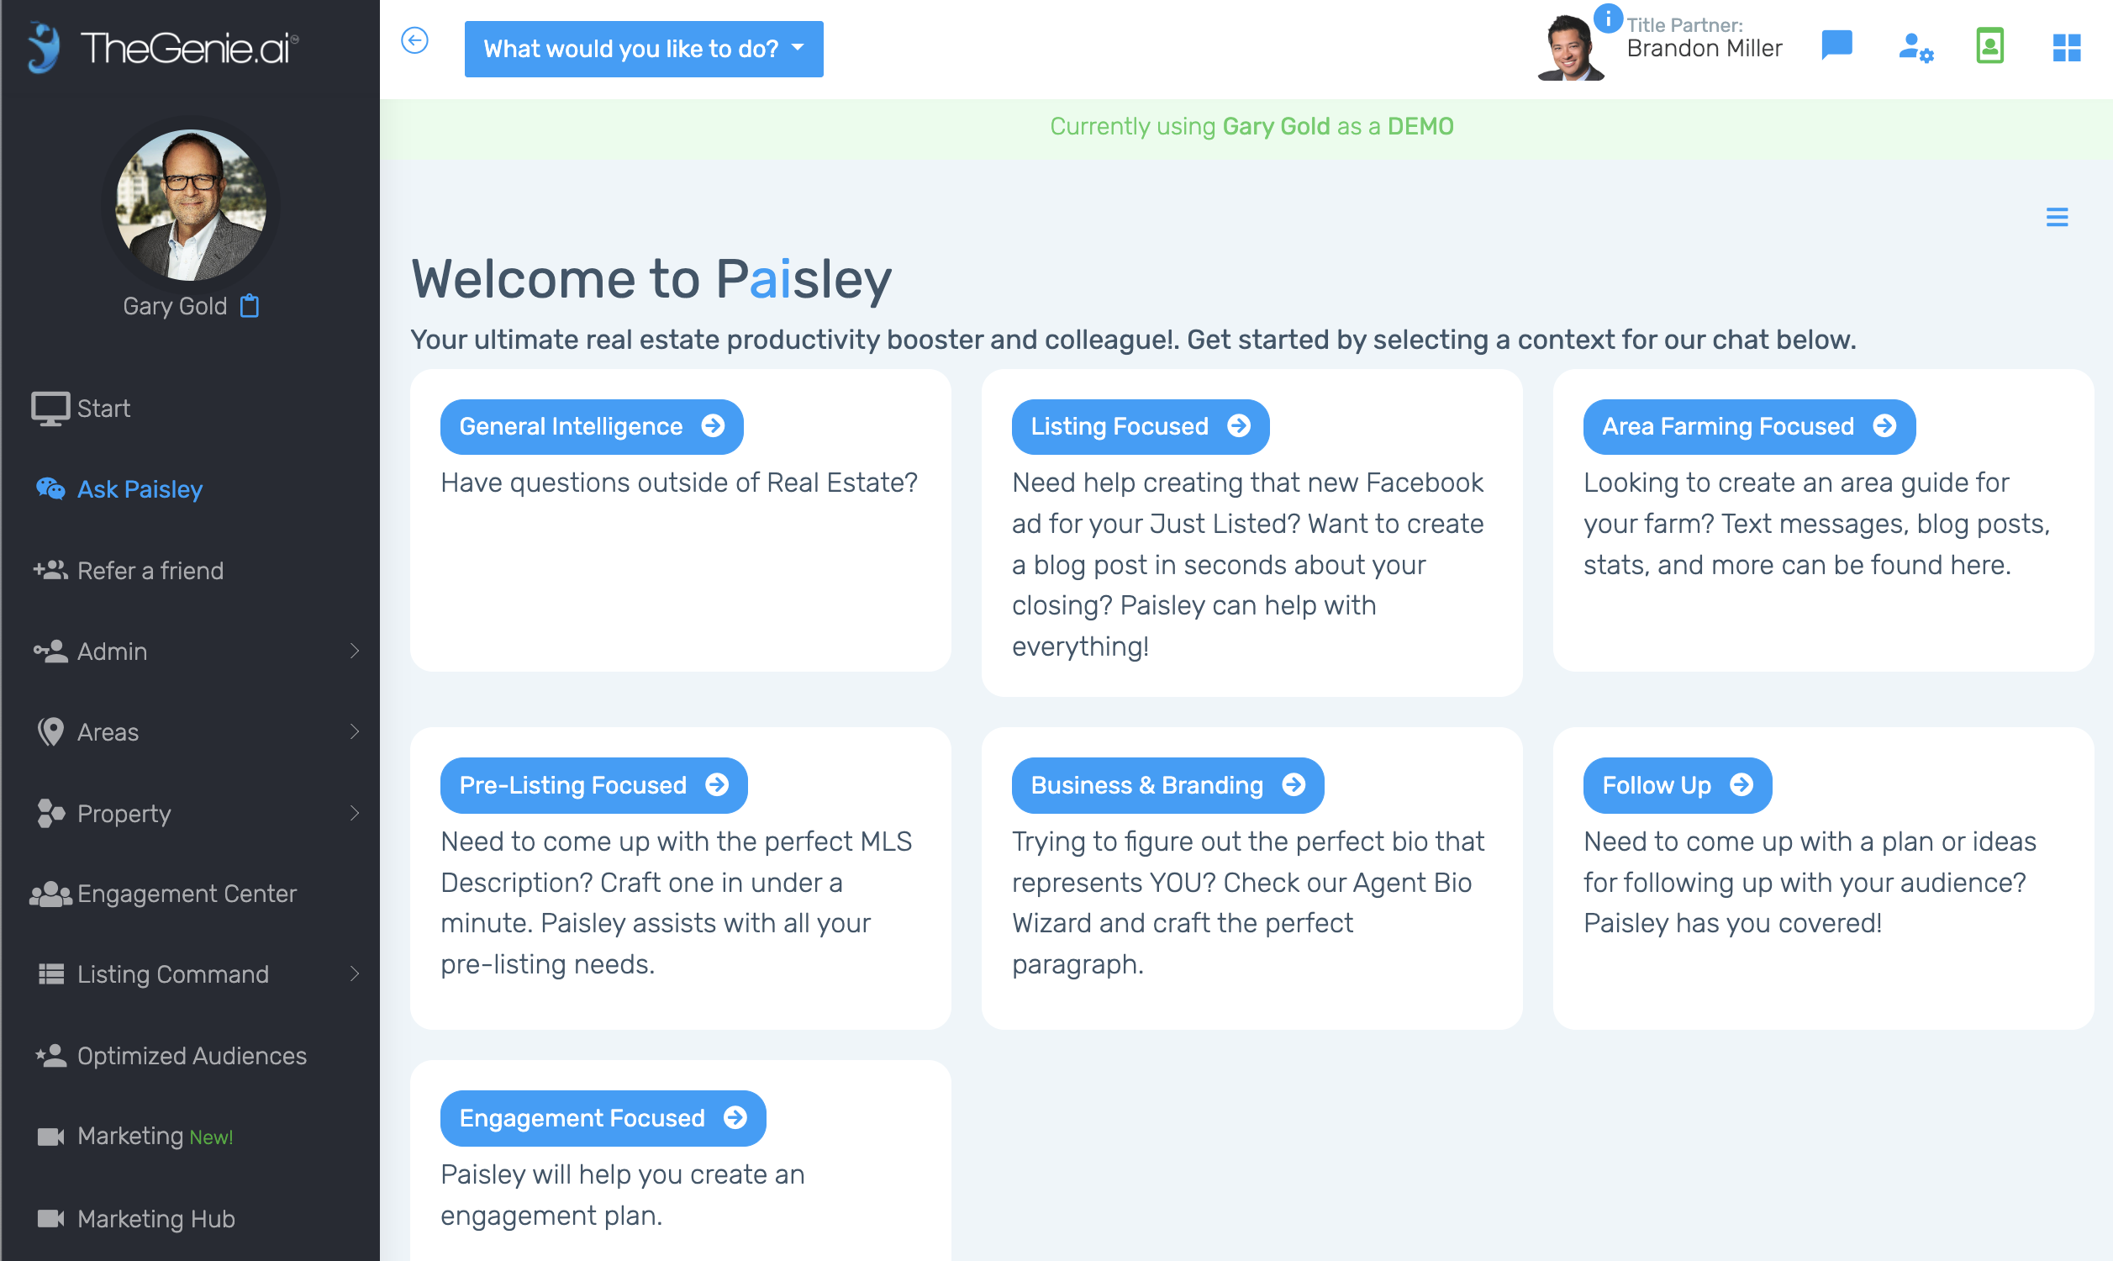
AskPaisley
3. Build Trust with Agents
“Knowledge is NOT regulated, empower your reps with VALUABLE KNOWLEDGE to build lasting trust.”
Refer and Recommend Paisley - Marketing Assistant AI
Offer KNOWLEDGE on competition & growth strategies
PRE LISTING Knowledge - Solutions to help agent earn the listing
Companies who think they are Competition: Title Toolbox, Title24/7, Dynamic Farm

Slide 8
Building Trust takes game changing gear
High Value
Comparing solutions that actively focus on listing generation.
TheGenie.ai & Paisley
Hard to Use
Easy to Use
Title
Toolbox
Dynamic Farm
Title24/7
Low Value

Slide 9

Close for more Title Orders
“Being integrated into the listing workflow gets our reps the title order before the listing hits MLS”
Trust translates to Partnerships - Value is irresistible
Be in the CENTER of every LISTING - as partner in the workflow
Earn the Title Order BEFORE listing is entered into MLS
Competition: Other Title Companies

Slide 10
Be in the center of the listing transaction and CLOSE more Title Orders
High Value
Hard to Use
Easy to Use
Title Co 1
Title Co 4
Title Co 2
Title Co 3
Low Value

Slide 11
Now INTRODUCING the Essence of our meeting: A RADICAL Marketshare Growth Plan
Notes:
agent attraction,

Slide 12
The Forward One Real Estate Network
A homeowner engagement platform to attract Sellers for listings by Zip Code
A system designed to engage homeowners with valuable knowledge designed to build trust, and stay top of mind when they think of selling.
Our growth plan requires three key components: 1. A dynamic brokerage with leadership experienced at radical growth
2. A scalable tech Stack to automate all growth & prospecting activities
3. A title Partner capable of providing experienced reps to support our listing agents in our targeted areas

Slide 13
Forward One Network Model
A nimble brokerage layer allowing us to select agents from any organization for referral partnerships
MASTER VISION -
1. With our proprietary GeoSocial Audience technology, we are able to surgically focus our footprint within zip codes.
2. We target a top 5 agent for each zip code we are targeting and execute shock n awe marketing to increase “at bats”
3. Homeowners we attract in our “net” become our co listing and our partner agent agrees to our title and escrow.
4. The agent can stay with their existing brokerage or join our brokerage.
5. Our approach is to turn great agents into celebrity agents by growing their marketshare in areas they are known

Slide 14
Forward One Leadership
Experience Matters
CEO - Paul Mark Morris President - Josh Spitzen Chief Innovator - Steve Hundley
Chief Experience - Joey Sacavitch
Founding Advisors:
Gary Gold
Merce Kollo

Slide 15
The Forward One Innovation Lab
A TECH STACK unmatched for homeowner engagement and agent attraction
Shock n Awe Farming - Genie.ai Omni Chanel Farming Tech automates and scales farming
Neighborhood Command - Personalized automate farming via Social, Digital, Print & Text
Listing Command - Set it and Forget it Circle Prospecting of our own Listings
Competition Command - INSTANT Circle prospecting of our competitor’s listings by Zipcode
Nurture Engine CRM - Pattern matching nurture system designed to convert top of funnel sellers
Proprietary GeoSocial Audience Technology - T360 believes 1.5 years ahead of market
Data Driven AGENT Attraction and Selection - We choose agents based on criteria
Growth plan starting in Los Angeles County - Select nationwide 24 month plan

Slide 16
Forward One Network Model
A nimble brokerage layer allowing us to select agents from any organization for referral partnerships
OUR TITLE PARTNER
1. We collaborate with our title partner on selecting agents
2. F1 engages agent and is responsible for brining on board and introduce to our title partner
3. Our title partner provides farm mapping services for our selected agent.
4. Our title partner is invited to be integrated into new listing workflow.

Slide 17
Thank You

Slide 18
TheGenie.ai
Agent Attraction
“Teach an agent 1 thing they don’t know about themself, you will get in the door… every time”
Agent Scorecard - Select agents based on potential title revenue
Patented Farm Analyzer - Uncover “pockets of listing opportunities”
Share KNOWLEDGE competitors don’t have
Typical inferior options: Broker Metrics, Altos Research, MyMTA

Slide 19
Solutions for Attracting TOP REALTORS
High Value
The Genie.AI
Hard to Use
MyMTA
Easy to Use
Altos
Broker Metrics
Low Value

Slide 20
Lower transaction volume
Higher title rep competition among the few winning realtors
F1 Vision
Newer Realtors are less subscribed to the ‘relationship based’ model. Title business is transactional.
Many Realtors don’t close any deals. Title reps struggle to get conversations started with the few that do.

Slide 21
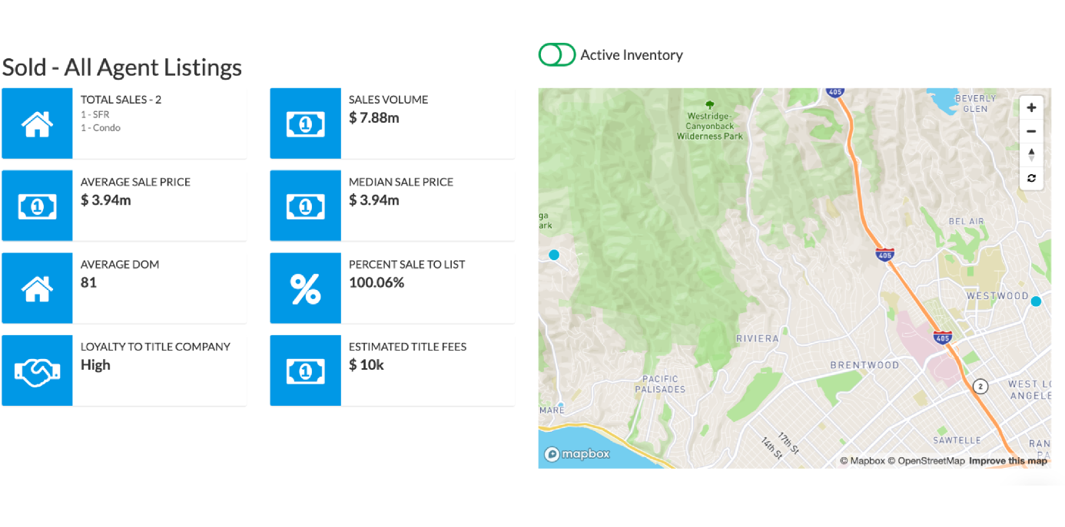
Don’t know which agents to target?
Let TitleGenie take care of it for you.

Slide 22
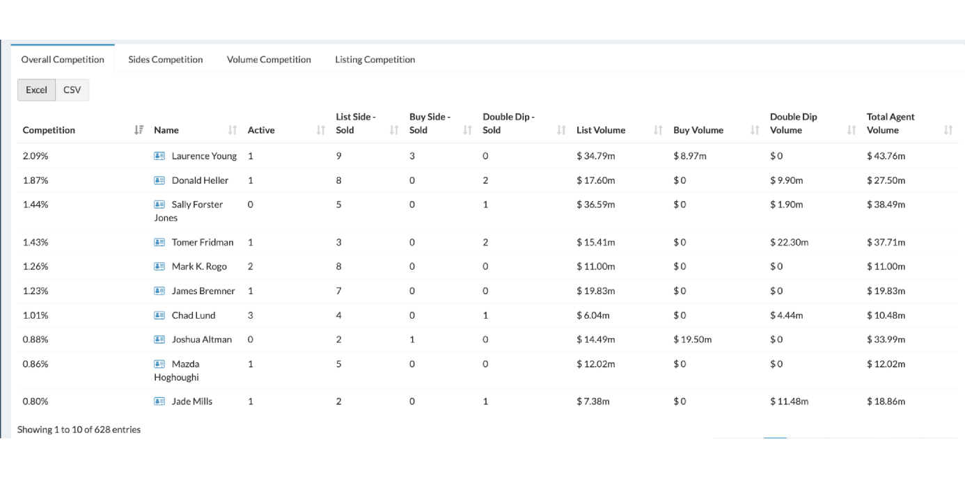
Ever wondered how you can bring value to your Realtors?
Title genie is the only platform that showcases realtors their competition data.

Slide 23
Our Bread and Butter: DATA
TitleGenie lets you analyze areas like a stock pick, nailing down exact strategies you can recommend to agents

